Slide 1
Layout
Data Visualization

Slide 2
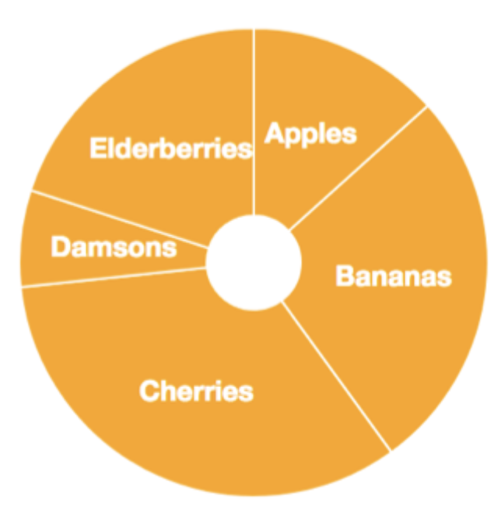
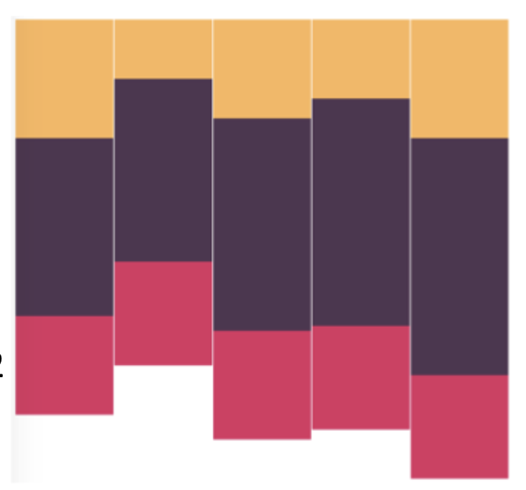
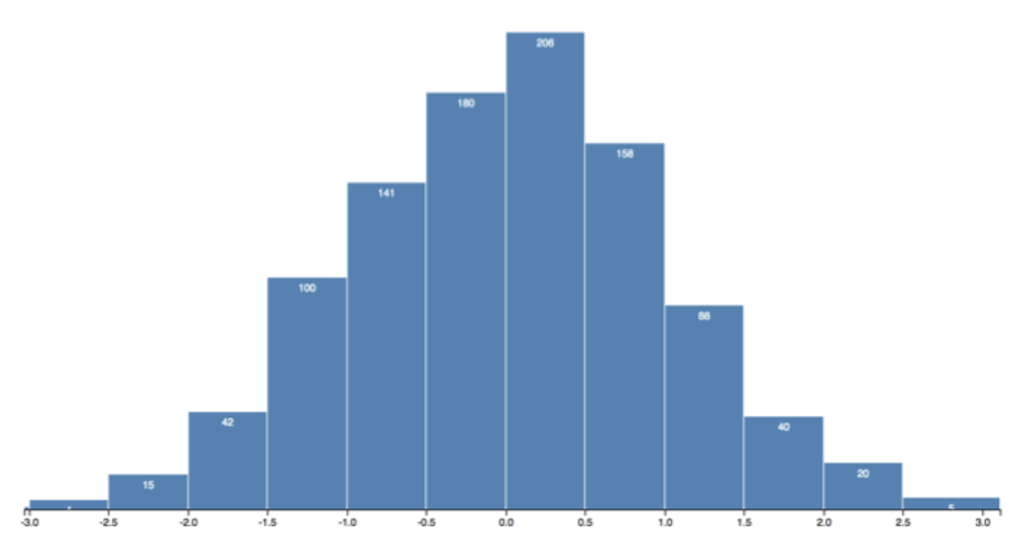
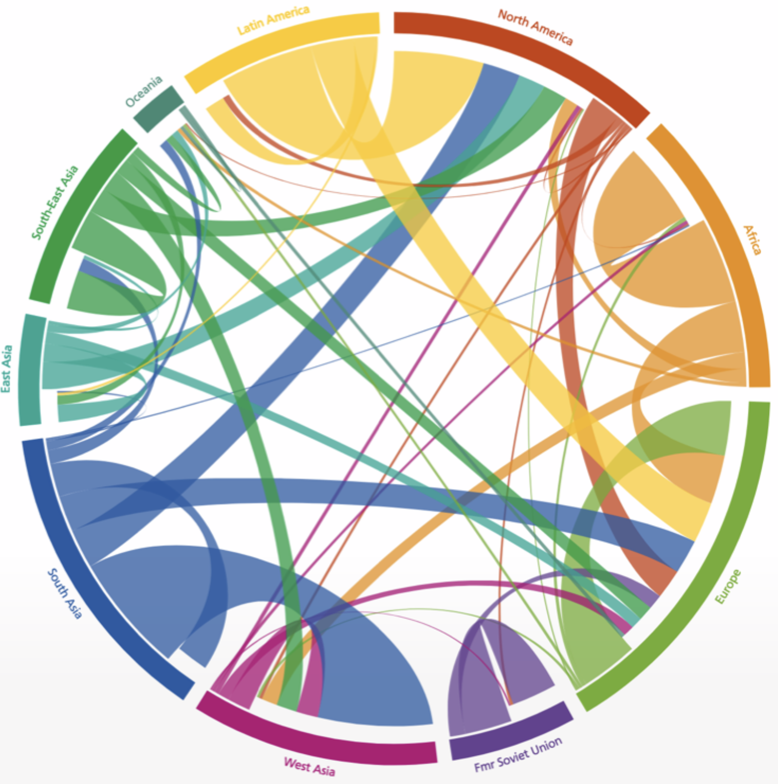
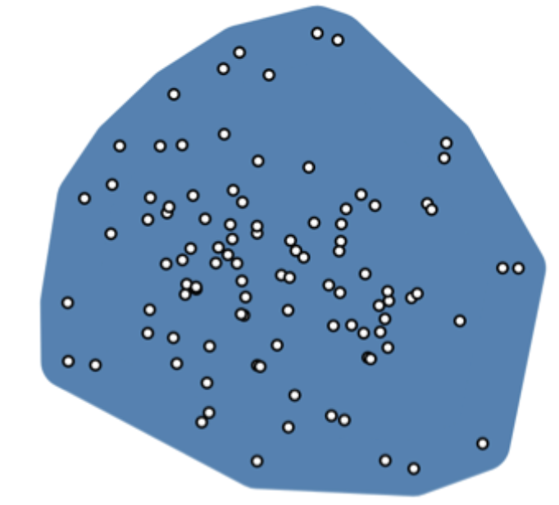
Layouts
In essence, a layout function in D3 is just a JavaScript function that
Takes your data as input
Computes visual variables such as position size to it so that we can visualize the data
Pie, stack bar, histogram, chord, convex hull

Slide 3
Pie Generator: d3.pie()
Given an array of data, the pie generator computes the necessary angles to represent the data
Output an array of objects containing the original data augmented by start and end angles which can be used to draw a pie chart by d3.arc()

Slide 4
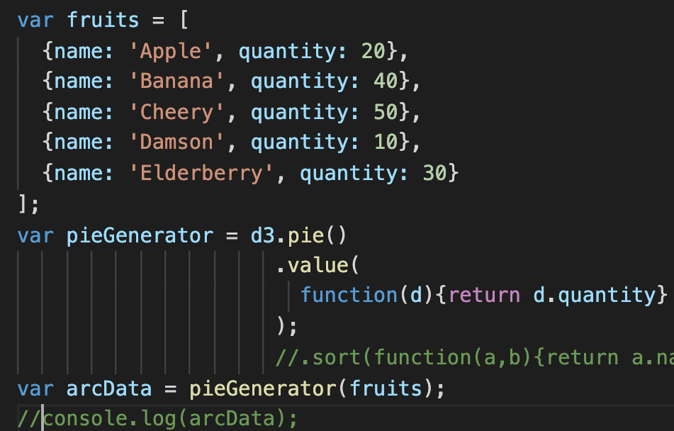
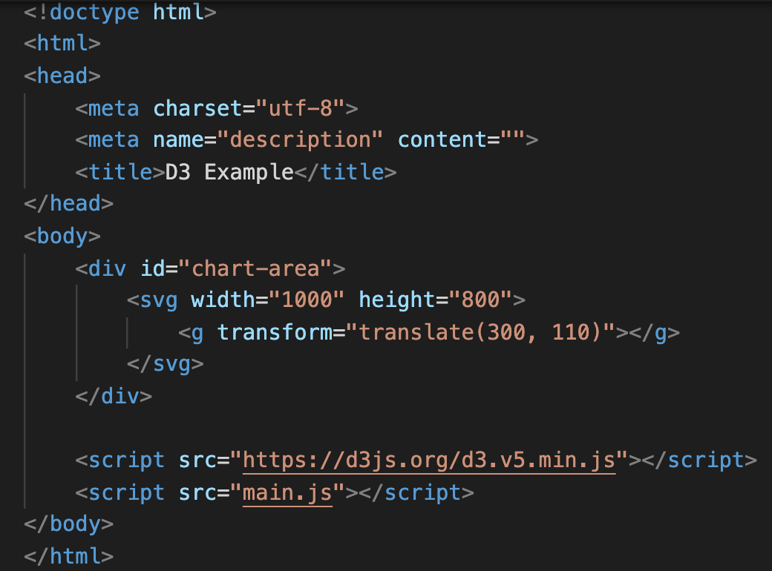
Pie Generator (Ex10-01 )
Tell d3.pie() that to get data values from ‘quantity’ attribute of each elements in the data array
data
Index.html
I have created a ‘svg’ and a ‘g’ in index.html

Slide 5
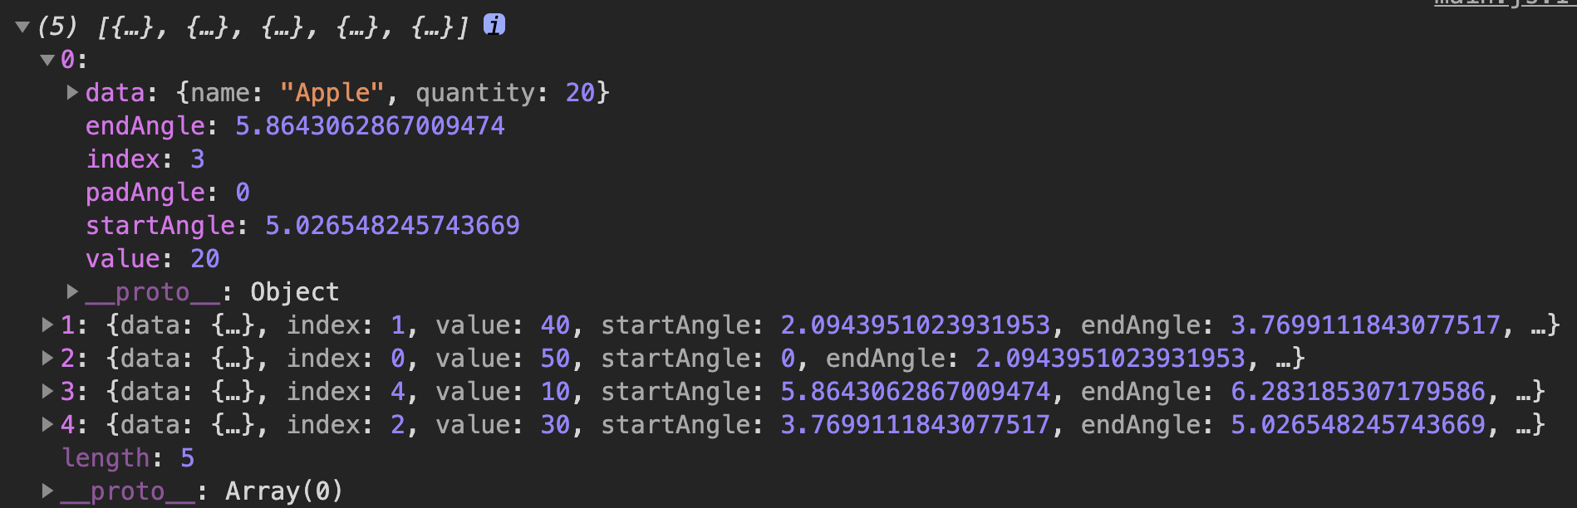
Pie Generator (Ex10-01 )
Send our data array to the pie generator
‘arcData’ stores the information for d3.arc() to draw the pie chart
If we print it out

Slide 6
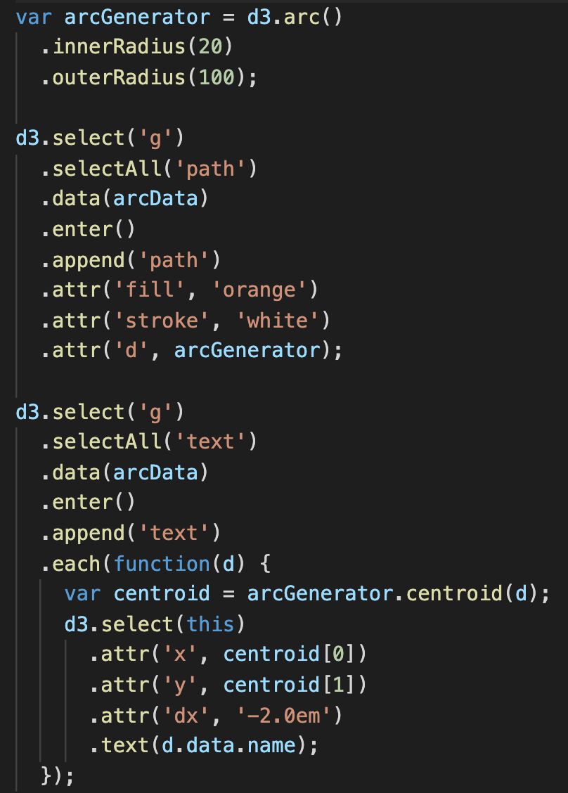
Pie Generator (Ex10-01 )
We also need the arc generator here to draw arcs
After you get the ‘arcs’ information from pie chart generator, the rest of work is the same as Ex05-07 (draw multiple arcs)
Bind the arcs information calculated from pie chart generator
Data element is fed to arcGenerator to generate path information

Slide 7
Pie Generator (Ex10-01 )
After you get the ‘arcs’ information from pie chart generator, the rest of work is the same as Ex05-07 (draw multiple arcs)
This is ‘arcData’
Generate text on pie chart
The way to get ‘name’ from arcData

Slide 8
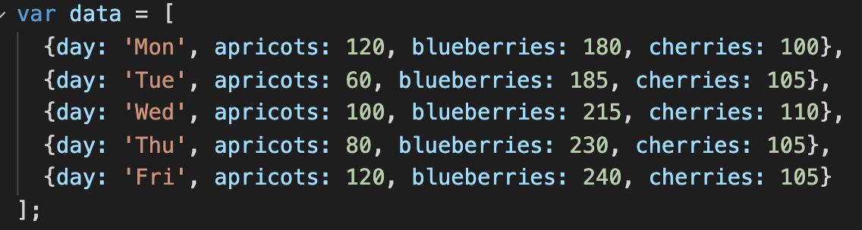
Stack Generator
A classic visualization from stack generator is stack bars
They are used to show how a larger categories is divided into smaller categories and what the relationship of each part has on the total amount
Column
Mon. ~ Fri.
different fruits sales volume from Mon. to Fri. (Ex10-02)
Orange: apriocots
Purple: blueberries
red: cherries

Slide 9
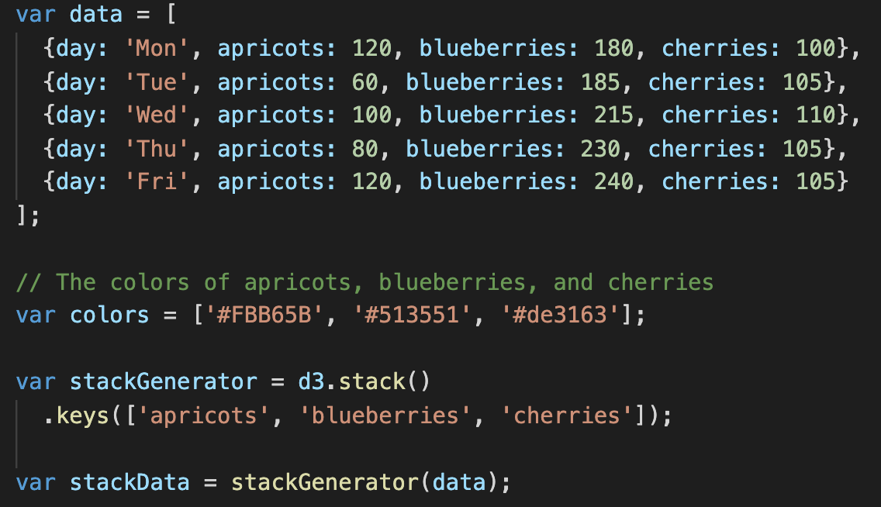
d3.stack (Ex10-02)
In order to send the data to d3.stack(), the data should be array of dictionaries.
Each element in the order will be stacked together
Send the array of ‘key’ to d3.stack().keys()
Let d3.stack() know what values should be used to create the stacks
Send the data to the stack generator. It will return the information about how to layout the stacks

Slide 10
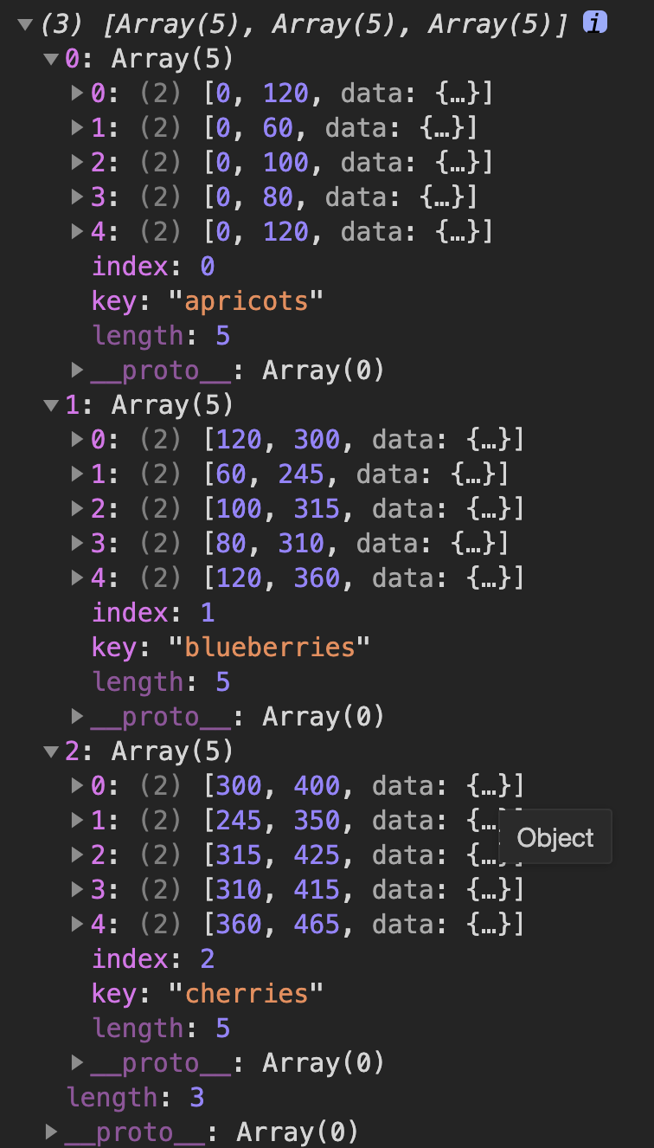
d3.stack (Ex10-02)
Mon.
Tue.
Wed.
Thu.
Fri.
apricots
blueberries
chrries
Send the data to the stack generator. It will return the information about how to layout the stacks

Slide 11
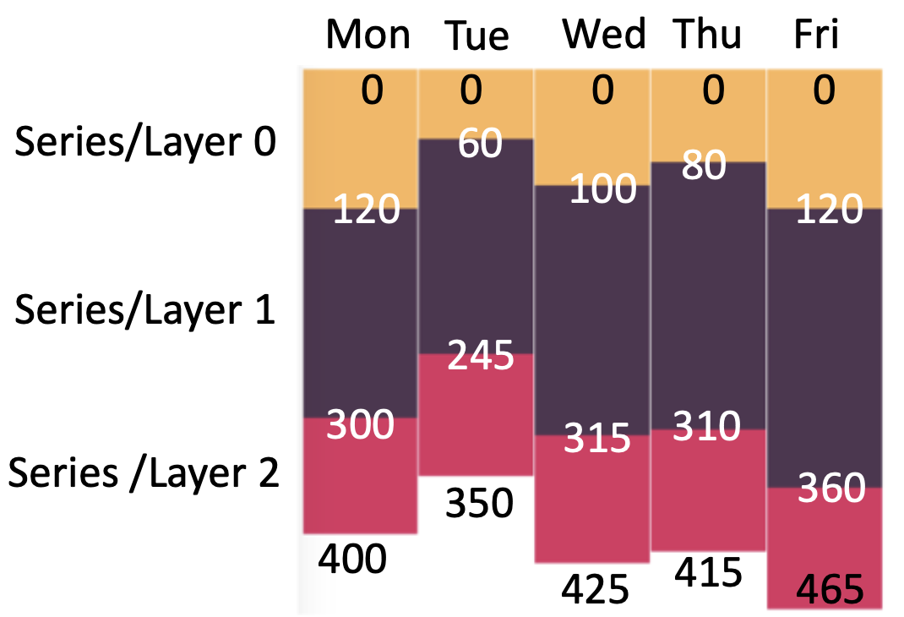
d3.stack (Ex10-02)
Mon.
Tue.
Wed.
Thu.
Fri.
apricots
blueberries
chrries

Slide 12
d3.stack (Ex10-02)
Mon.
Tue.
Wed.
Thu.
Fri.
apricots
blueberries
chrries

Slide 13
d3.stack (Ex10-02)
Mon.
Tue.
Wed.
Thu.
Fri.
apricots
blueberries
chrries

Slide 14
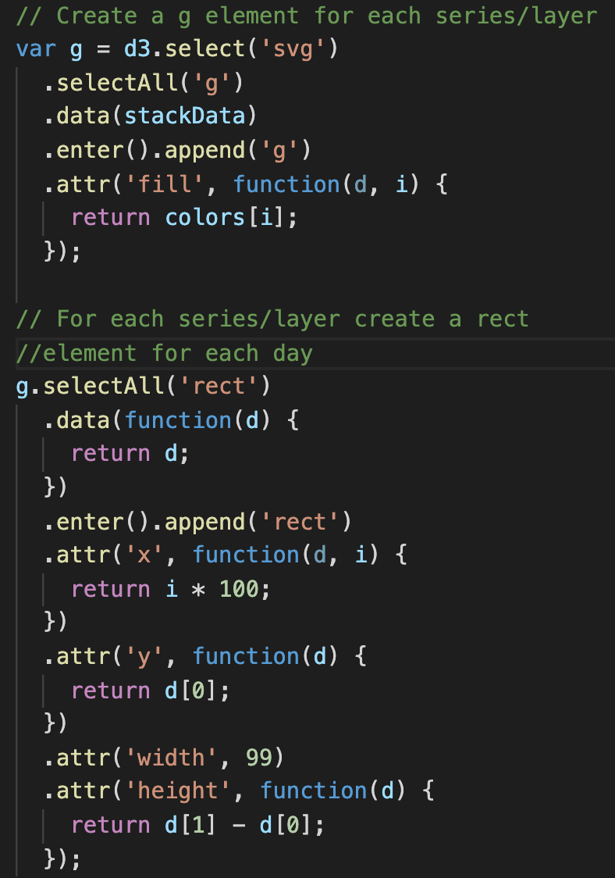
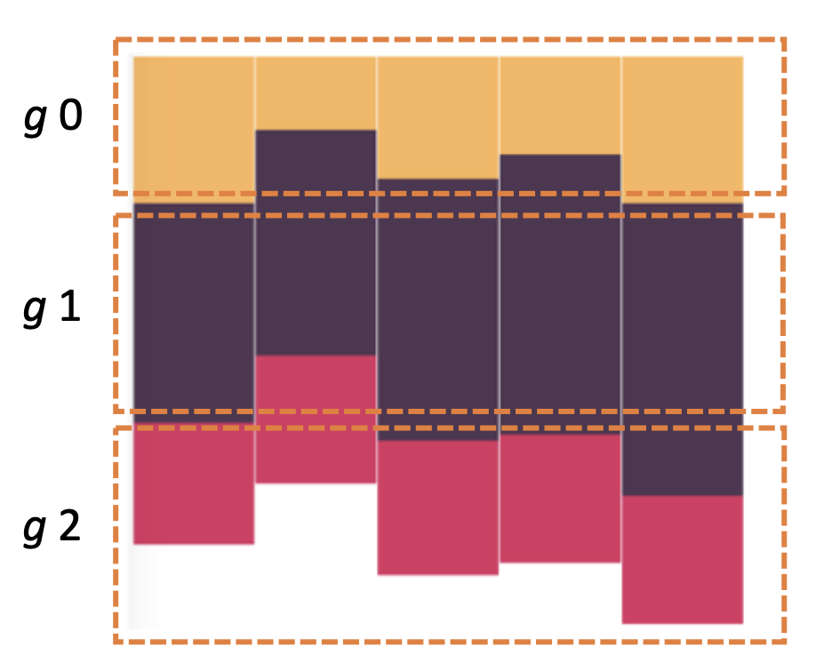
d3.stack (Ex10-02)
Which color to fill the shape in a <g>
Create ‘g’ for each fruits
So, the variable ‘var g’ contains three groups

Slide 15
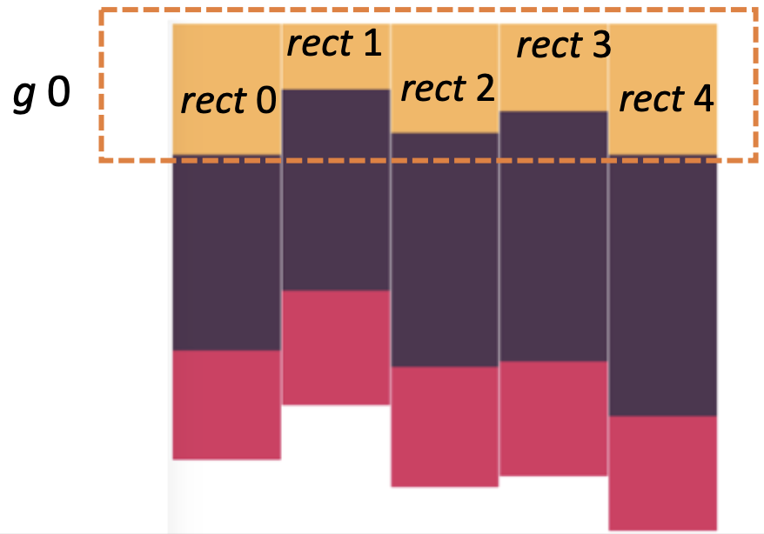
d3.stack (Ex10-02)
For each <g> tag, the data is an array computed by stackGenerator
E.g. the data [[0,120], [0,60], [0,100], [0,80], [0,120]] is attached to the first <g> in “var g“
Because ’g’ has three <g>, this statement will go through the three <g> and the corresponding data to create rectangles

Slide 16
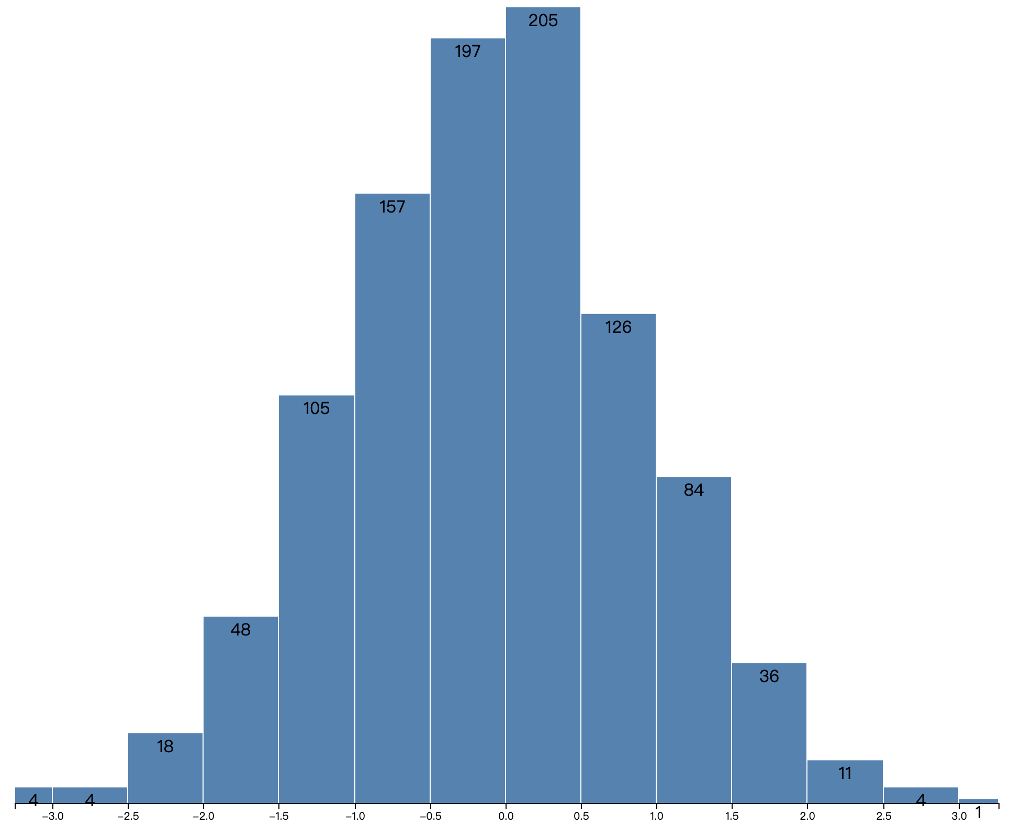
Histogram
Histograms bin many discrete samples into a smaller number of consecutive, non-overlapping intervals
They are often used to visualize the distribution of numerical data

Slide 17
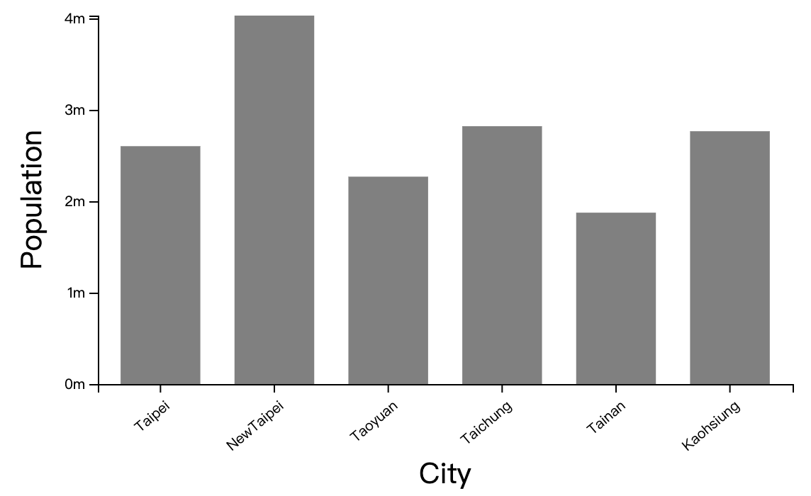
Draw Histogram From Data Points
Recall how to draw bars (Ex04-16)
In Ex04-16, our data array directly store the height (simply map from the population) to draw the bars
Now, our data array stores the data points. We have to divide the data domain into multiple bins and calculate how many data point fail into each bin
d3.histogram can help us for this calculation
Ex04-16

Slide 18
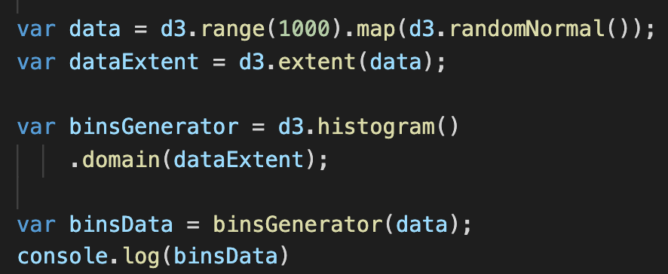
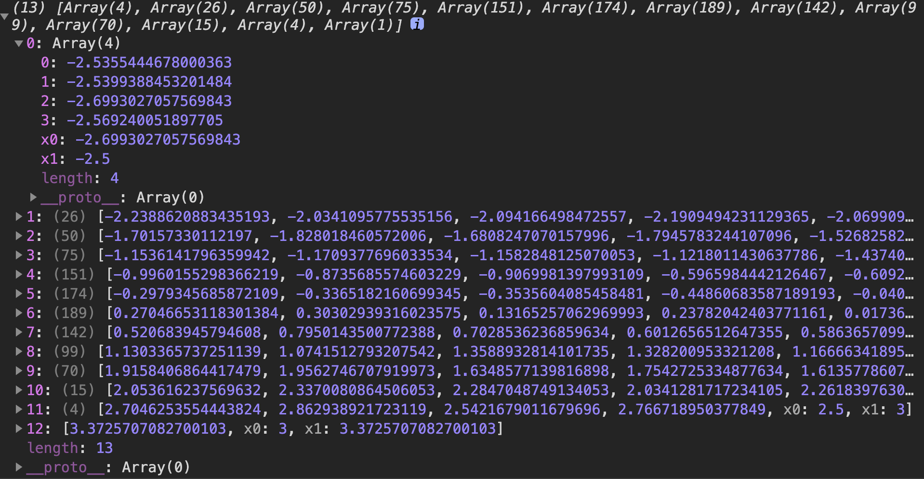
Draw Histogram From Data Points (Ex10-3)
Pass data to the histogram generator
It will return you each bin ‘s lower bound (x0), upper bound(x1) and number of elements in that bin (length)
Generate data with 1000 data points and get the min and max values
binData
The first bin info.
Data elements fall into the first bin
Lower bound of the first bin
Upper bound of the first bin
Create the histogram generator function and give it the domain range
We have 4 data elements in the first bin
It can automatically determine a proper number of bins form you or you can specify it
We have 13 bins in total

Slide 19
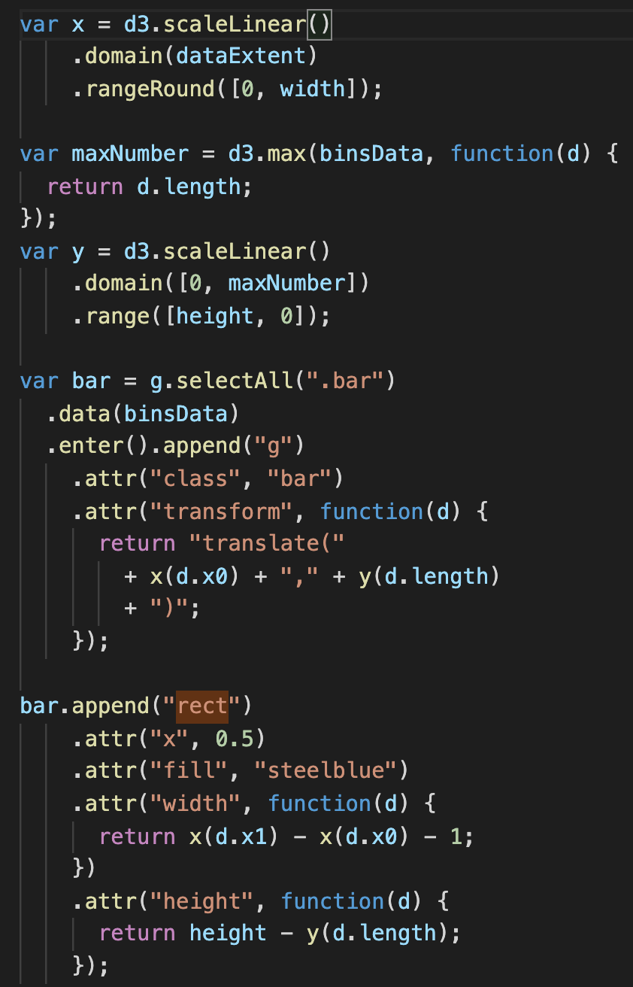
Draw Histogram From Data Points (Ex10-3)
After you know the lower bound, upper bound, counts of each bin, the following step is almost the same as draw a bar chart

Slide 20
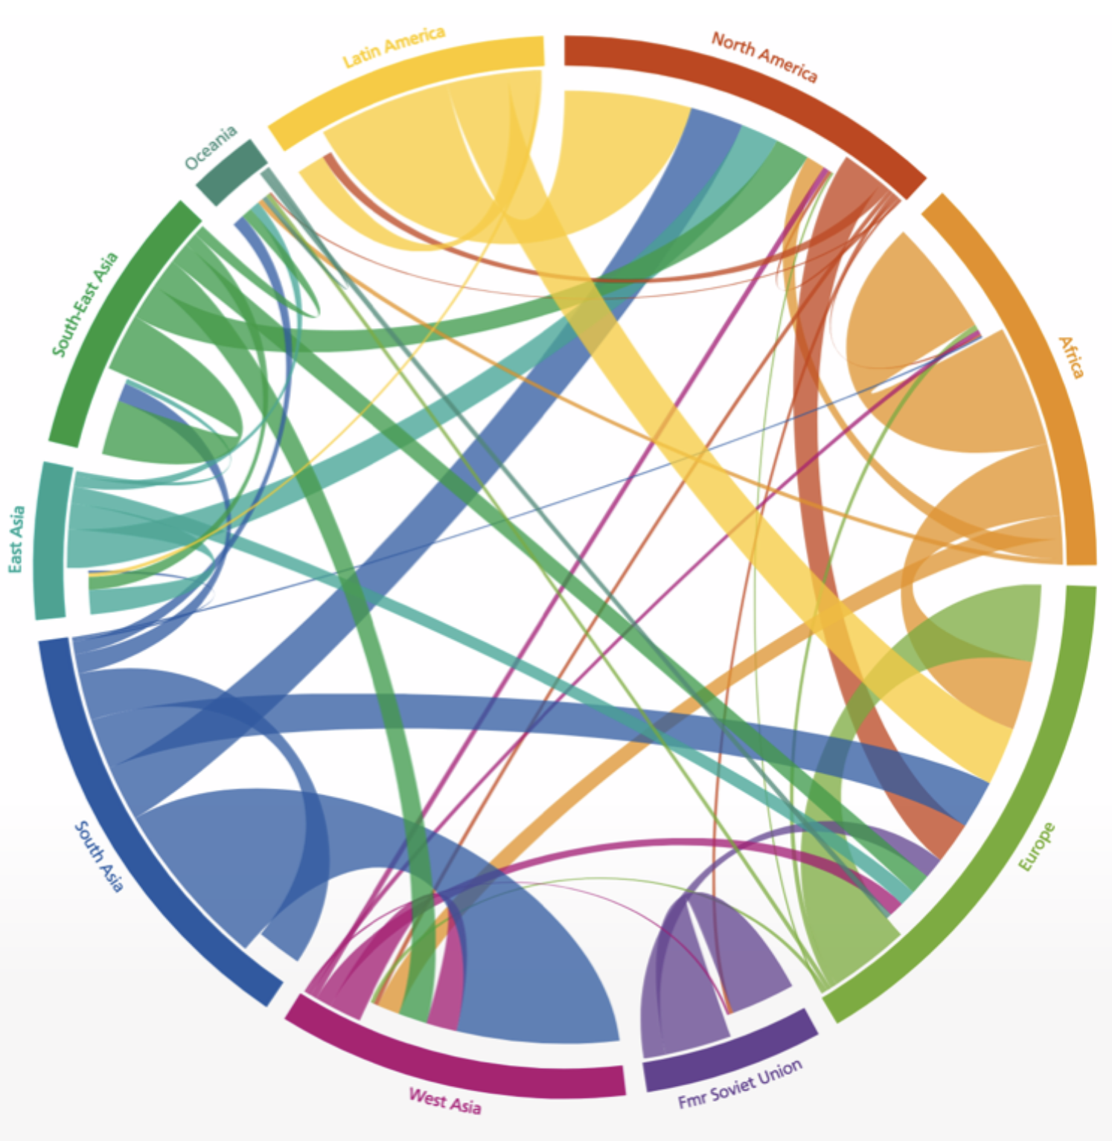
Chord
Chord diagrams visualize links (or flows) between a group of nodes, where each flow has a numeric value.
Example
Migration flow between and within regions
Not our code example!

Slide 21
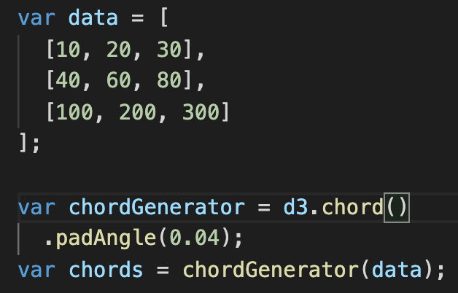
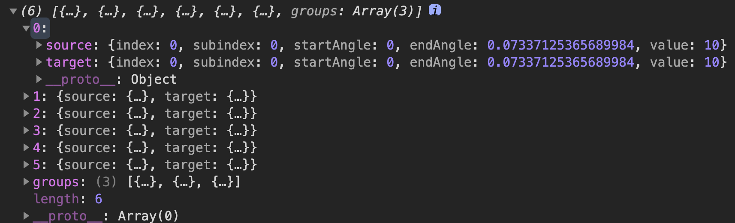
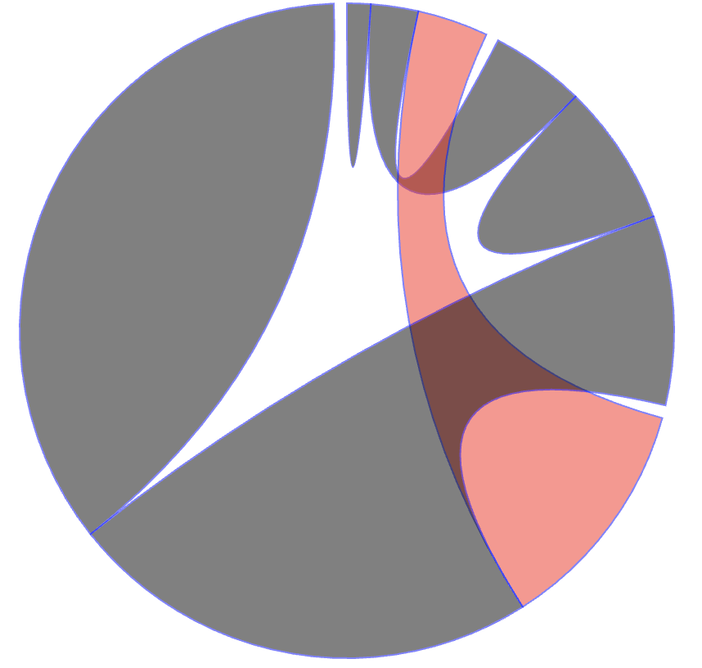
Chord Generator: d3.chord()
d3.chord()
Compute startAngle and endAngle of each data item
.padAngle(): set padding angle (gaps) between adjacent group
A 2D matrix to describe the transition among 3 groups
chords
Information of a ribbon
Only 6 ribbons
(if we have 3 groups A B C
A-A, B-B, C-C, A-B, B-C, A-C)
This is a ribbon

Slide 22
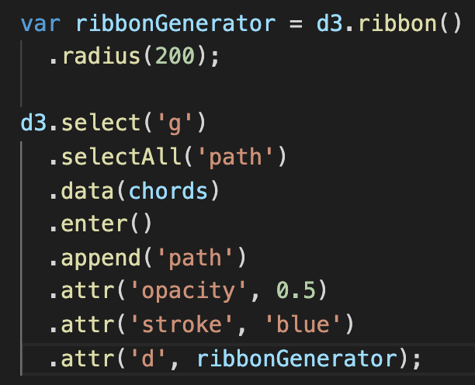

Ribbon Generator: d3.ribbon()
After we have ribbons’ information, we can use ribbon generator (d3.ribbon()) to generate paths and draw
d3.ribbon()
Converts the chord properties (startAngle and endAngle into path data so that we can draw chord by SVG
.radius(): control the radius of the final layout
Bind the data to paths
‘d’ is the information to describe the path shape.
‘ribbonGenerator’ here indicates that the data bound to a path will pass to the ribbonGenerator to generator the path

Slide 23
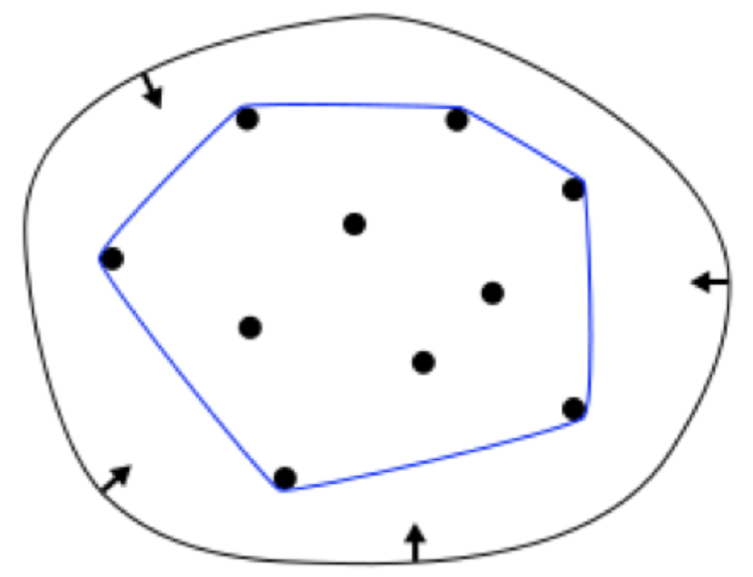
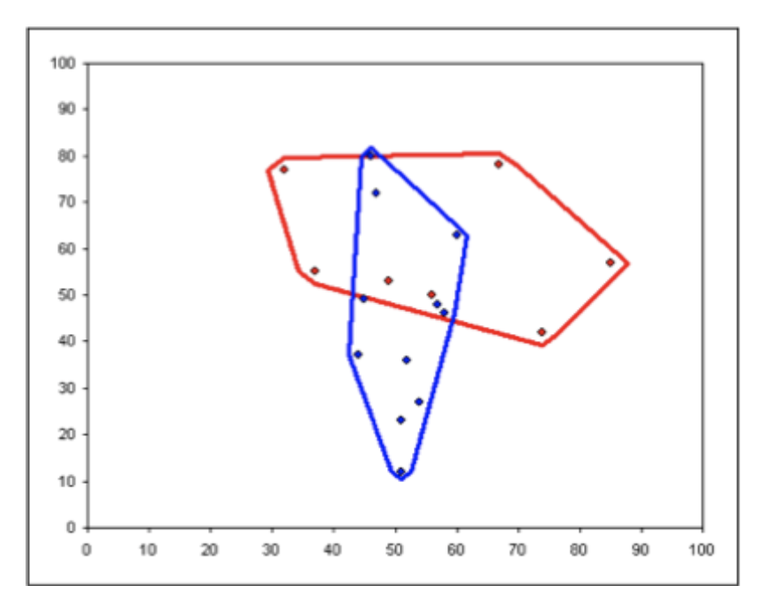
Convex Hull
In mathematics, the convex hull of a set of points in a Euclidean space is the smallest convex set that contain the points
Application: visualize different sets/clusters of points on the screen

Slide 24
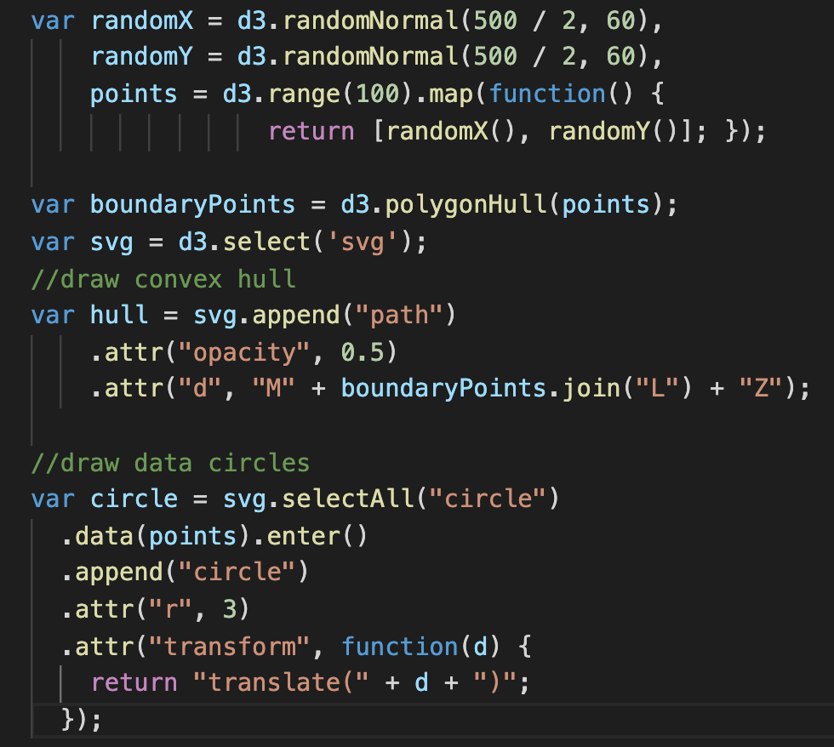
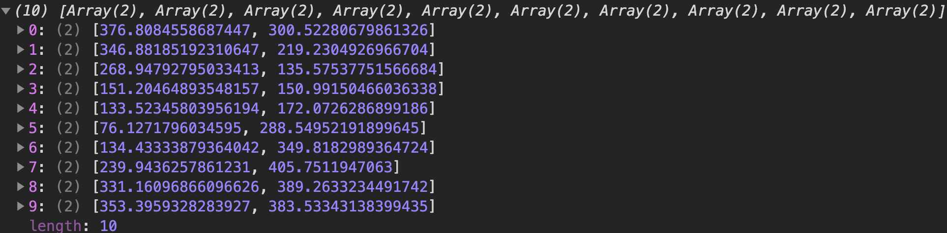
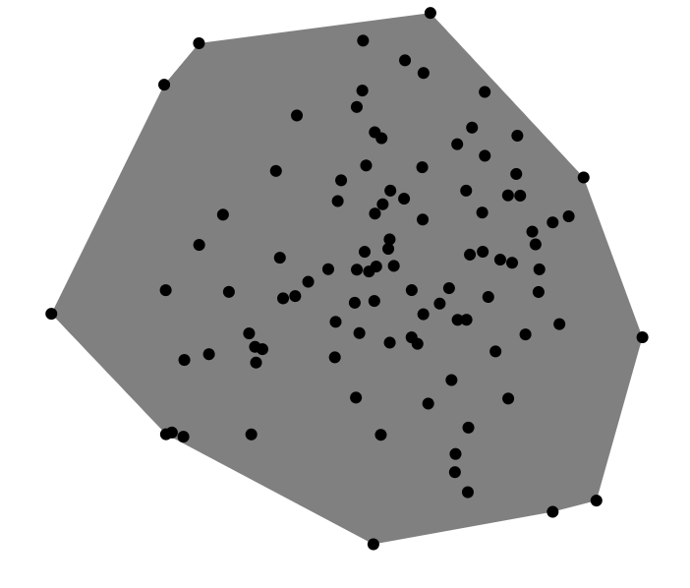
Convex Hull – d3.polygonHull()
d3.polygonHull()
Pass data point to it
it calculates boundary points for you
Generate 100 x-y pair and store them in ‘points’
They are the boundary points
Draw the polygon by the boundary points
Draw all points by circles

